Slide 1

ANALYSIS & PREDICTION OF CRIME RATE IN CHICAGO
SDM GROUP PROJECT
Team Members
Prithvi Kocherla (#U50193006)
Ramreddy Duddela (#U62350397)
Harshavardhan Reddy Perugu (#U40159362)

Slide 2
INTRODUCTION:
Crime is ubiquitous and lot of innocent people are falling victims to crimes around the world every single year.
All of the reported crimes are being recorded and their details are available.
On the other hand, software technology is transcending to new levels.
Hence, we thought of integrating it with the theoretical concepts of Statistics to find value in the available data.
This integration can lead us in a direction which enables to analyse and predict future scenarios.

Slide 3
IMPORTANCE OF ANALYSIS:
In the contemporary world, crime is raising at an alarming rate due to easy access to illegal arms, drugs etc. facilitated by advancements in technology.
This imposes a need for identifying and analyzing patterns and trends in crime and disorder that can occur in a region, by which they can either be prevented or handled effectively.
This estimation helps the respective law enforcement departments to efficiently deploy and manage resources as required and in turn formulating new crime prevention strategies.

Slide 4

WHY DO WE CARE:
It is a bigger problem than it seems to be
In USA alone, 20.1 violent crime victimizations per 1,000 people have been reported according to the Bureau of Justice Statistics’ (BJS) National Crime Victimization Survey (NCVS) in 2014
Above stats do not account for unreported criminal activities
which makes it more serious
Approximately 60% of the reported incidents have occurred
in major cities
This made us focus on Crime reports data of one such
city i.e. Chicago, IL, USA where the crime rate
has been quite high over the past few years
WHY SHOULD OTHERS CARE:

Slide 5
WHAT OTHERS HAVE STUDIED:
NCVS conducts surveys and collects data related to different types of criminal activities
These statistics provide useful information on how certain groups of people are more susceptible to crime
In cities like Pittsburgh PA, which has one of the highest murder rates among large U.S. cities, predictive policing program developed by scientists at Carnegie Mellon University is being used currently.
Police car laptops will display maps showing locations where crime is likely to occur, based on data-crunching algorithms. In theory, the maps could help cops do a better job of preventing crime.

Slide 6
OBJECTIVE OF OUR STUDY:
From the available real time crime data of Chicago, we would first visualize the data to try and get a better understanding of it.
Want to show growth trend patterns on graph plots for representational purposes.
Then suitable analytical approach will be used for predictive analysis to estimate district wise crime rate intensity in Chicago.
Later, we would try to predict if a person could get arrested for the crime type committed in a certain location by training and testing our dataset.

Slide 7
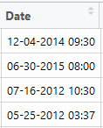
DATA COMPLICATIONS:
The required dataset is gathered from “Kaggle.com”, which initially had around 23 columns and 62,000 rows.
It became difficult in both analysis and modelling on this huge data set.
Hence, Data Cleansing operations are performed,
- Redundant columns have been removed manually.
- Initial Date column is unformatted and was causing problem
in analysis, hence using R code, it is properly structured.
- Some of the cells are empty valued and are to be removed
for analysis, hence done through R by using below code,
CrimeData5 <- CrimeData5[!is.na(CrimeData5$Latitude),]

Slide 8
DATA COMPLICATIONS (Contd..)
One of our objective was to see crime results as per the time of the day. So here it needed us to extract the time from Date column and divide into parts. It was done in R
CrimeData5$TimeMod <- times(format(CrimeData5$DateMod, "%H:%M:%S"))
When observed the different types of Crimes, we found out 28 and it was difficult to project/ analyse through plot.
Hence, certain similar crime types have been grouped and tagged as one kind,
Ex: Crime Types of BURGLARY, THEFT, MOTOR VEHICLE THEFT, ROBBERY are tagged as 'THEFT’
This resulted in Crime Types to decrease to 12 distinct categories.

Slide 9
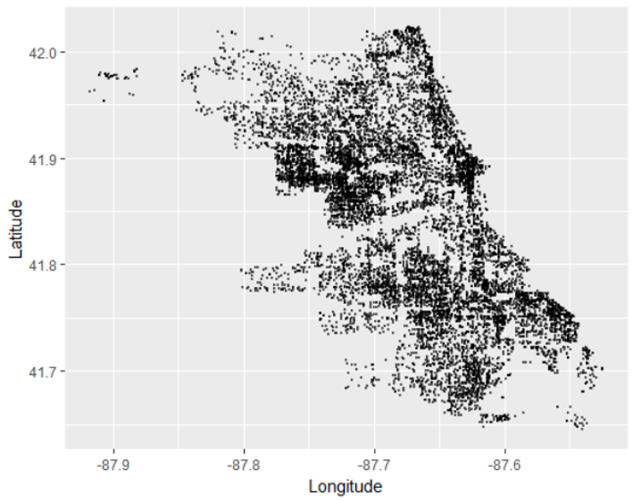
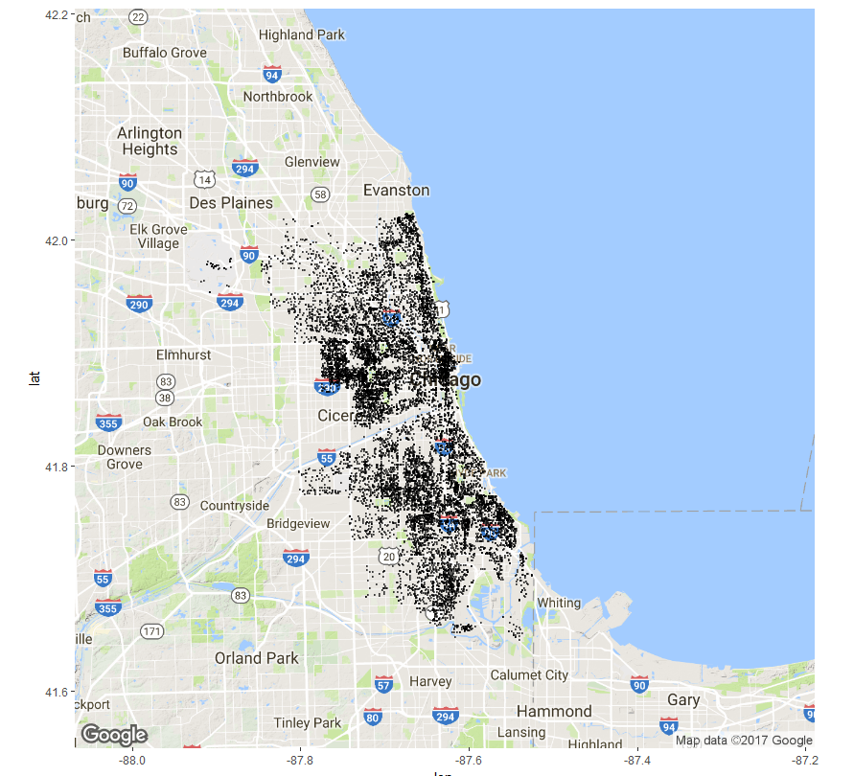
DATA VISUALIZATION:
All the crime records of Chicago Data plotted using ggplot
Crime Data Records plotted on Chicago Map

Slide 10
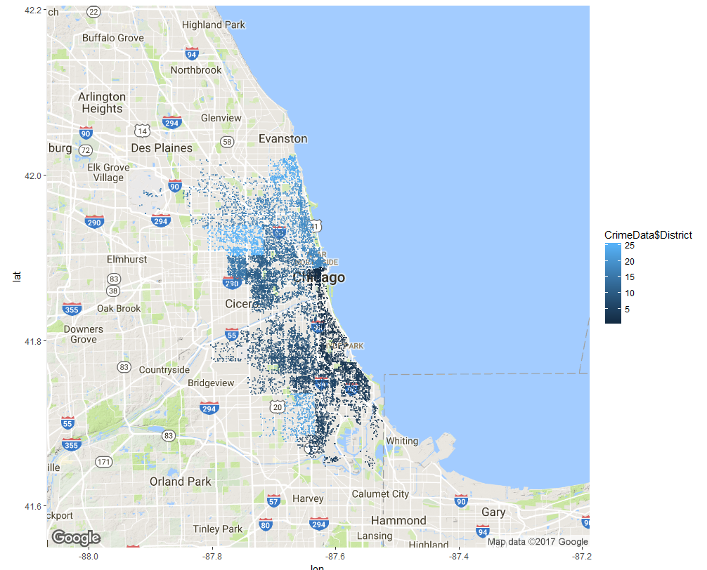
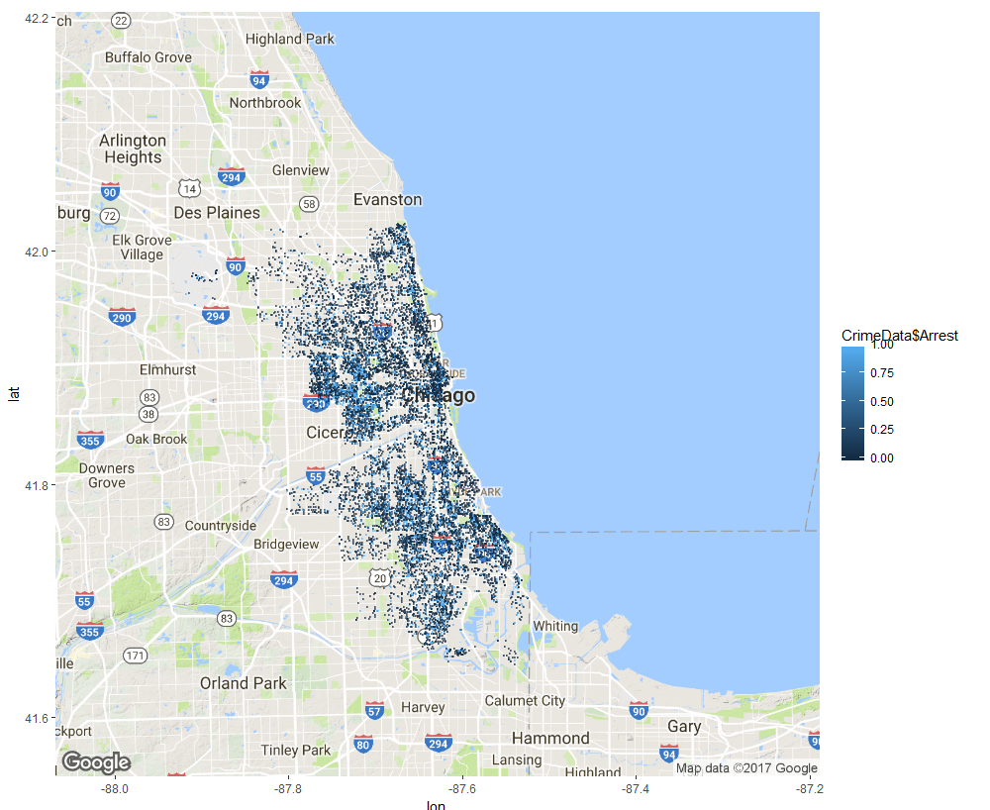
DATA VISUALIZATION (Contd..)
DATA VISUALIZATION (Contd..)
Crime Records grouped by District colour coding
Plot showing all Crime Records distinguished by Arrest column = 1.

Slide 11
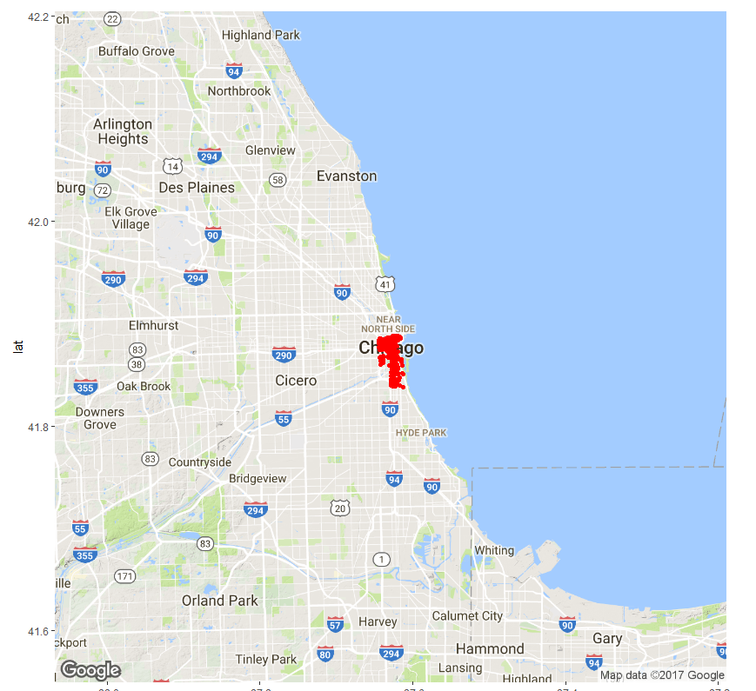
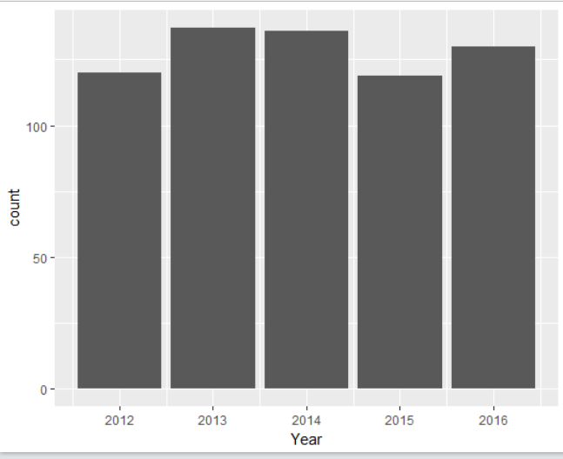
DATA VISUALIZATION (Contd..)
Plot showing Crime Records in District 1
Bar plot showing the count of crimes by Year with District 1

Slide 12
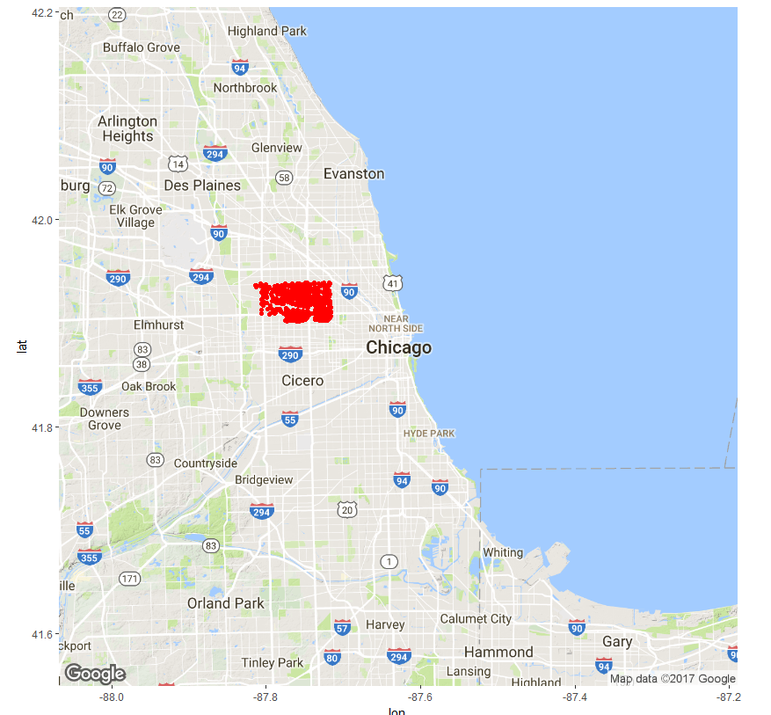
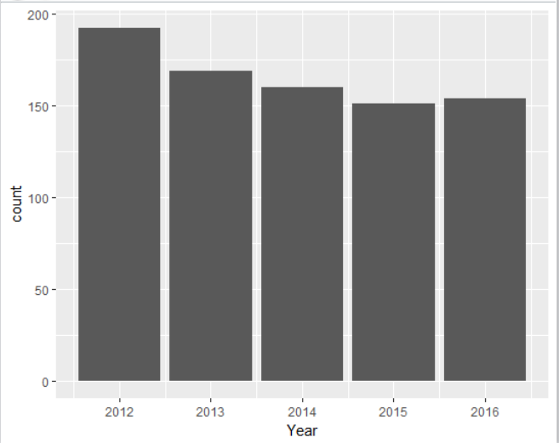
DATA VISUALIZATION (Contd..)
Plot showing Crime Records in District 25
Bar plot showing the count of crimes by Year with District 25

Slide 13
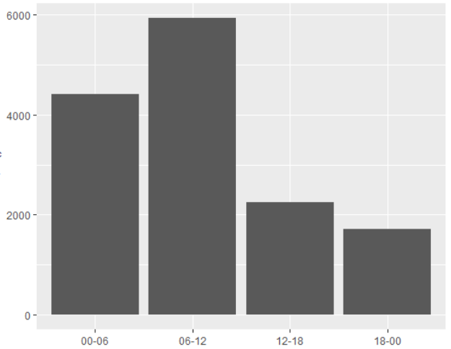
DATA VISUALIZATION (Contd..)
Plot showing the count of crime records vs the time part in a day.
Here values on X-axis imply,
00-06: 12AM to 6AM
06-12: 6AM to Noon
12-18: Noon to 6PM
18-00: 6PM to 12PM
Interestingly it is observed that most of the crimes happen around time 6AM to 12PM.

Slide 14
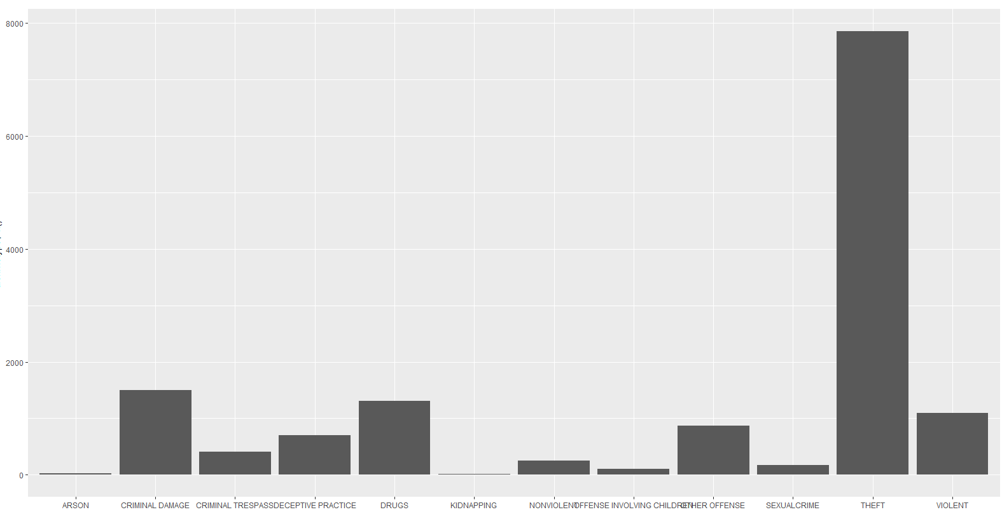
DATA VISUALIZATION (Contd..)
Plot showing the count of Crime Records vs different Crime Types

Slide 15
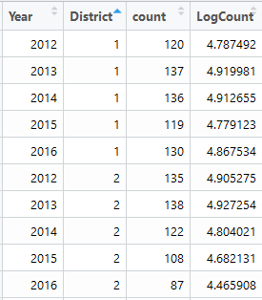
ANALYSIS:
From the records present, a separate Data Frame has been loaded that contain Year, District, Count.
Linear Regression:
- R^2 value obtained is around 0.27, this is due to points not in a linear trend.
- Hence, we converted the count to Log values to obtain a linear model.
-Through Exponential approach, it was observed that the R^2 value has been increased slightly relative to former approach.
- From this, prediction has been done on count for the year 2017.

Slide 16
INFERENCE:
From the predicted count values of year 2017, it is observed that there is decline in crime rate in comparison to previous values of a certain district.
Yet, in the output results we saw an increment by 23% rate in District 18.
Hence, using these values it could be apt to allocate law enforcement resources that helps in their management.
We initially thought of focussing on major crime type by district wise and based on it predicting the next possible occurrence.
- But as per data constraints and limited regression models that are known presently to us, we could not make it.
- Our analysis could have made more impact with that approach.

Slide 17
THANK YOU!

